Slide 1
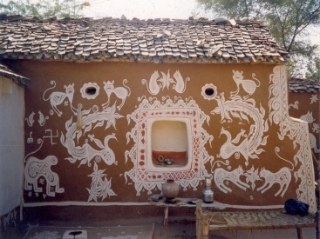
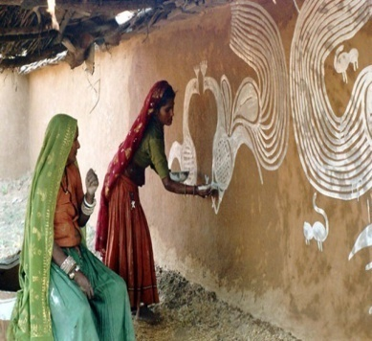
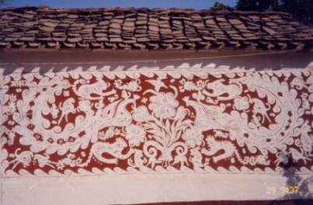
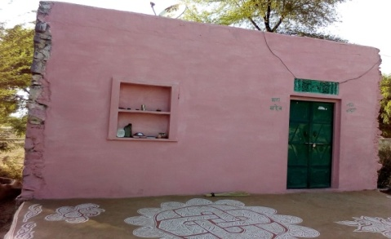
The magnificence of the
Pictorial heritage
THE REVIVAL OF MANADANA ART BY VILLAGE WOMEN
A comprehensive Mission of the heritage conservation of fast languishing Mandana , providing livelihood to the downtrodden tribal women painters
Ever Since our villages have been upgraded with cemented houses under government policies, we have been robbed off the beautiful mandanas that were painted on mud walled village huts. The then crafted artworks made using local colours (Hirmich - red brown clay, pilli mitti - ochre clay and Khadai mitti - white clay) which gave the local houses a personality of their own are now bare cemented walls are fast languishing because the white and red clay became difficult to work with on limestone walls.
These are highly spectacular forms of indigenous art enclosing a vast variety of wildlife and the local surroundings that are represented in a stylistic format capable of inspiring even the modernists and designers alike.
Our community action plan is to preserve the tradition systematically with a sense of generating self esteem and would ensure that these works could be displayed at international and national levels, but also these women could find reliable employment opportunities in near future.
All sensitive tourists and connoisseurs who were used to capturing these large scale wall art in the villages of Sawai Madhopur can now take home a piece of Mandana art to adorn their living rooms with.
Aayam is planning to establish a artists workshop and gallery near Tiger century where the women can come from their homes to create paintings and showcase them for sale in the gallery.
Mud wall hut adorned
with Mandanas
A free hand Mandanas paintings
Symmetry without pre sketching
New crude looking cemented walls
Email: aayamngo@gmail.com, Contact on: 9829065205

Slide 2
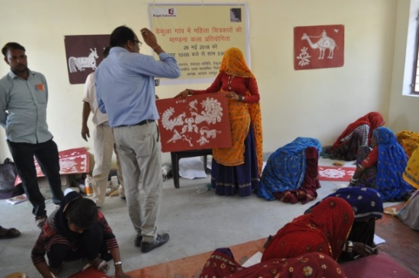
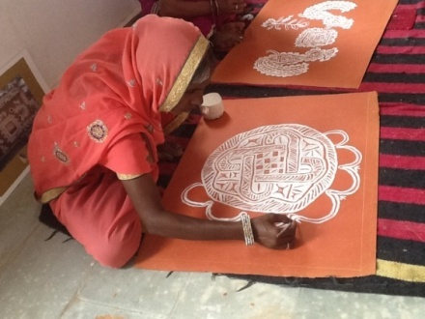
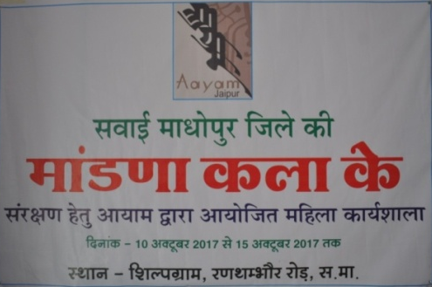
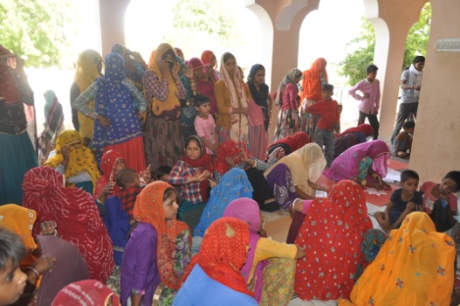
Mandanas have been integral part of the cultural heritage of villages. We at Aayam Institute of art and Culture have been taking well thought steps to revive the culture of mandana art in the following ways:-
a)Survey and Documentation :
We have been engaged in extensive surveying and documenting of the pictorial heritage for the last one decade. We have collected an extensive referential archive of Mandanas.
b) Identification of the talented women of the village by organizing artists competition.
During each of an art competition we are identifying 20 talented women artists from each of 100 participants of the village. The villages are also being selected after a survey.
c) women artists workshops The selected and awarded women Painters would be invited for the skill up gradation to teach them painting on alternative surfaces with ne medium for their expression. We had successfully organized artists camp for the women from 10th to 15thOctober 2017 in the vicinity of Sawai Madhopur itself. Our team of professional artists has trained women to make the same mandana done on walls on handmade sheets with brushes.Though done in acrylics these paintings exuberated the same flow and generic motifs that these ladies grew up watching. Without references or any pre thought concepts these ladies painted beautiful artworks that were each so unique that they were no longer just decorations. they were undoubtedly recognized as gallery worthy artworks for sale
d) Exposition of the saleable beautiful Mandana art at various levels
After the success of the art camp Dr. Chinmay Mehta Chairperson of the Aayam himself gave a digital presentation for the same at Jaipur Kala Chaupal on 25th November 2017.
Recently at the Jaipur Literature festival-2018 we displayed these paintings, Chief Minister of Rajasthan had also visited the show. she had not only appreciated our initiative but had also promised to support the same.
e) Establishing a Women Artists Workshop and Gallery in Ranthambhore
Taking this group effort forward Aayam would soon draft a proposal to identify a village near Ranathambhaur to establish a permanent women artists’ workshop and a Gallery there which can further be popularized as a heritage village restoring the Mandana art. Once we are able to successfully develop a women Painters Atelier in a village we shall further expand the same in many other villages.
Prof. Chinmay Mehta ,Chairperson AAYAM
Aayam organizing artists competition.
Aayam organizing artists workshop
Enthusiastic Women Mandana painters
Learning to paint on Handmade sheets
Email: aayamngo@gmail.com, Contact on: 9829065205

Slide 3
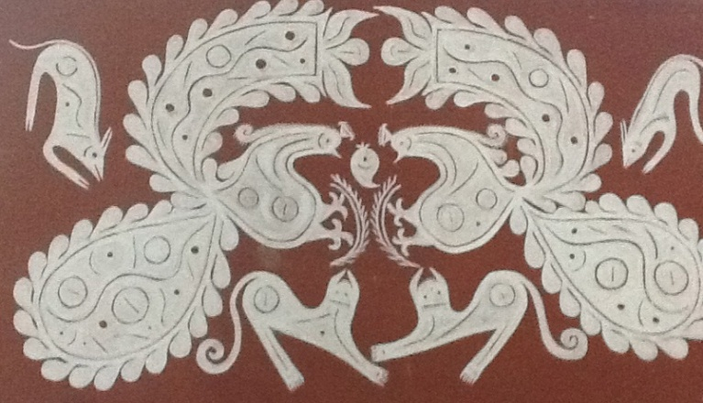
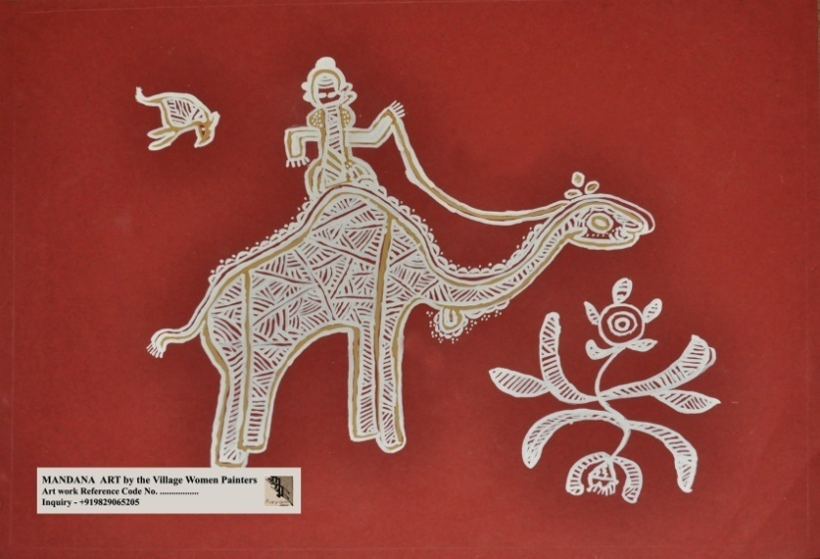
The Budgetary requirements to implement the holistic vision
b) Identification of the talented women of the village by organizing artists competition.
During each of an art competition we are identifying 20 talented women artists from each of 100 participants of the village. The villages are also being selected after a survey.
c) women artists workshops The selected and awarded women Painters would be invited for the skill up gradation to teach them painting on alternative surfaces with ne medium for their expression. We had successfully organized artists camp for the women from 10th to 15thOctober 2017 in the vicinity of Sawai Madhopur itself. Our team of professional artists has trained women to make the same mandana done on walls on handmade sheets with brushes. Though done in acrylics these paintings exuberated the same flow and generic motifs that these ladies grew up watching. Without references or any pre thought concepts these ladies painted beautiful artworks that were each so unique that they were no longer just decorations. they were undoubtedly recognized as gallery worthy artworks for sale.
Email: aayamngo@gmail.com, Contact on: 9829065205

